Slide 1

https://sahibulsaif.wordpress.com/wisdom/bismillah-nature/

Slide 2
Transforming er/EEr to relational model
CSC271 – DATABASE SYSTEMS

Slide 3
Previous Lecture Overview

Slide 4
Today’s Lecture
In this lecture, you will learn:
Mapping Associative Entities
Mapping Unary Relationship
Mapping Ternary Relationship
Mapping Supertype/Subtype

Slide 5
Transforming EER Diagrams into Relations (cont.)
Mapping Associative Entities
Identifier Not Assigned
Default primary key for the association relation is composed of the primary keys of the two entities (as in M:N relationship)
Identifier Assigned
It is natural and familiar to end-users
Default identifier may not be unique

Slide 6
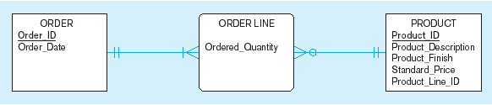
Example of mapping an associative entity
An associative entity

Slide 7
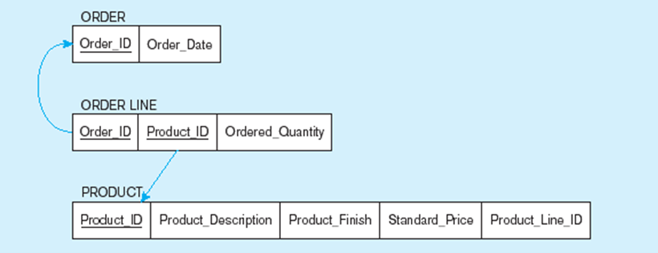
Example of mapping an associative entity (cont.)
Three resulting relations
Composite primary key formed from the two foreign keys

Slide 8

Example of mapping an associative entity with
an identifier
SHIPMENT associative entity

Slide 9
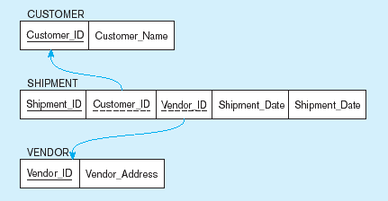
Example of mapping an associative entity with
an identifier (cont.)
Three resulting relations

Slide 10
Transforming EER Diagrams into Relations (cont.)
Mapping Unary Relationships
One-to-Many – Recursive foreign key in the same relation
Many-to-Many – Two relations:
One for the entity type
One for an associative relation in which the primary key has two attributes, both taken from the primary key of the entity

Slide 11
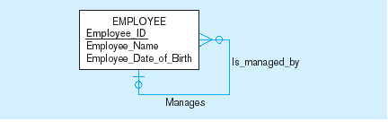

Mapping a unary 1:N relationship
EMPLOYEE entity with unary relationship
EMPLOYEE relation with recursive foreign key

Slide 12
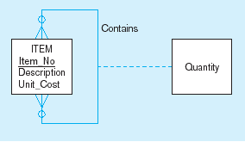
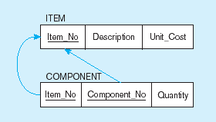
Mapping a unary M:N relationship
Bill-of-materials relationships (M:N)
ITEM and COMPONENT relations

Slide 13
Transforming EER Diagrams into Relations (cont.)
Mapping Ternary (and n-ary) Relationships
One relation for each entity and one for the associative entity
Associative entity has foreign keys to each entity in the relationship

Slide 14
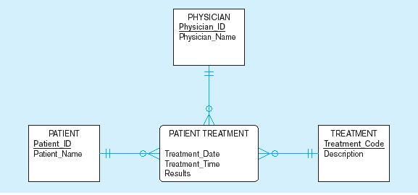
Mapping a ternary relationship
PATIENT TREATMENT Ternary relationship with associative entity

Slide 15
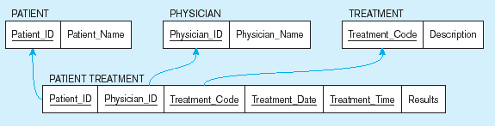
Mapping a ternary relationship (cont.)
Mapping the ternary relationship PATIENT TREATMENT
This is why treatment date and time are included in the composite primary key
Remember that the primary key MUST be unique
But this makes a very cumbersome key…
It would be better to create a surrogate key like Treatment#

Slide 16
Transforming EER Diagrams into Relations (cont.)
Mapping Supertype/Subtype Relationships
One relation for supertype and for each subtype
Supertype attributes (including identifier and subtype discriminator) go into supertype relation
Subtype attributes go into each subtype; primary key of supertype relation also becomes primary key of subtype relation

Slide 17
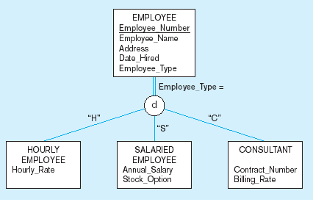
Supertype/Subtype relationships

Slide 18
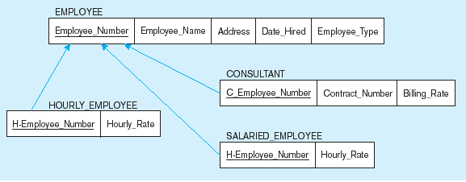
Mapping Supertype/subtype relationships to relations
These are implemented as one-to-one relationships

Slide 21

http://www.thomasformo.com/category/qa/

